Slide 1
Frame Processing
Gun Automobile
Edwin Lee, Andrew Maksymowsky, William Kingsford
Notes:
Andrew

Slide 2
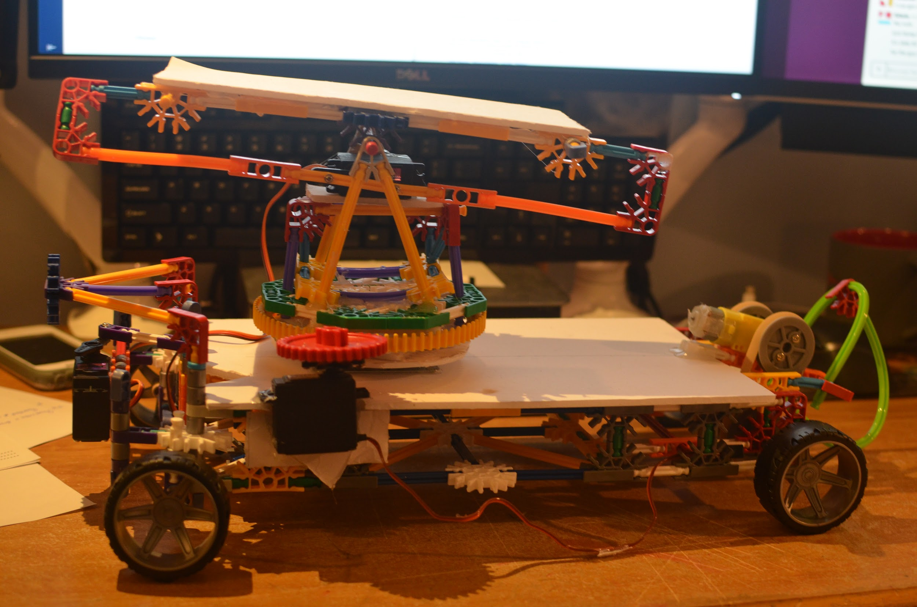
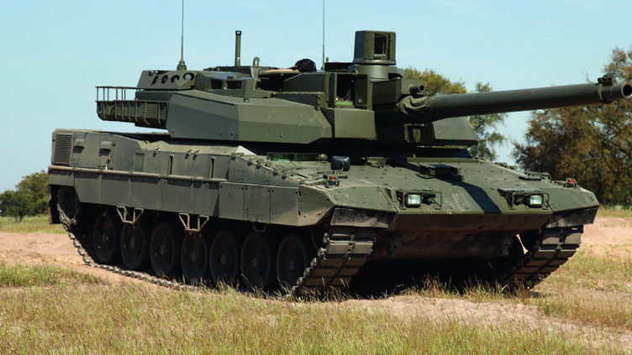
Overview
You
The guy she tells you not to worry about
Notes:
Andrew

Slide 3
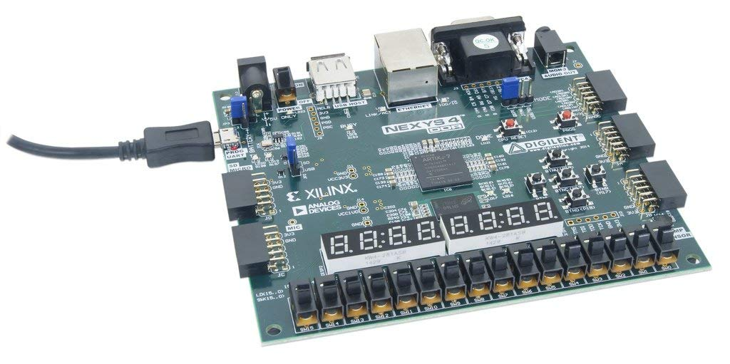
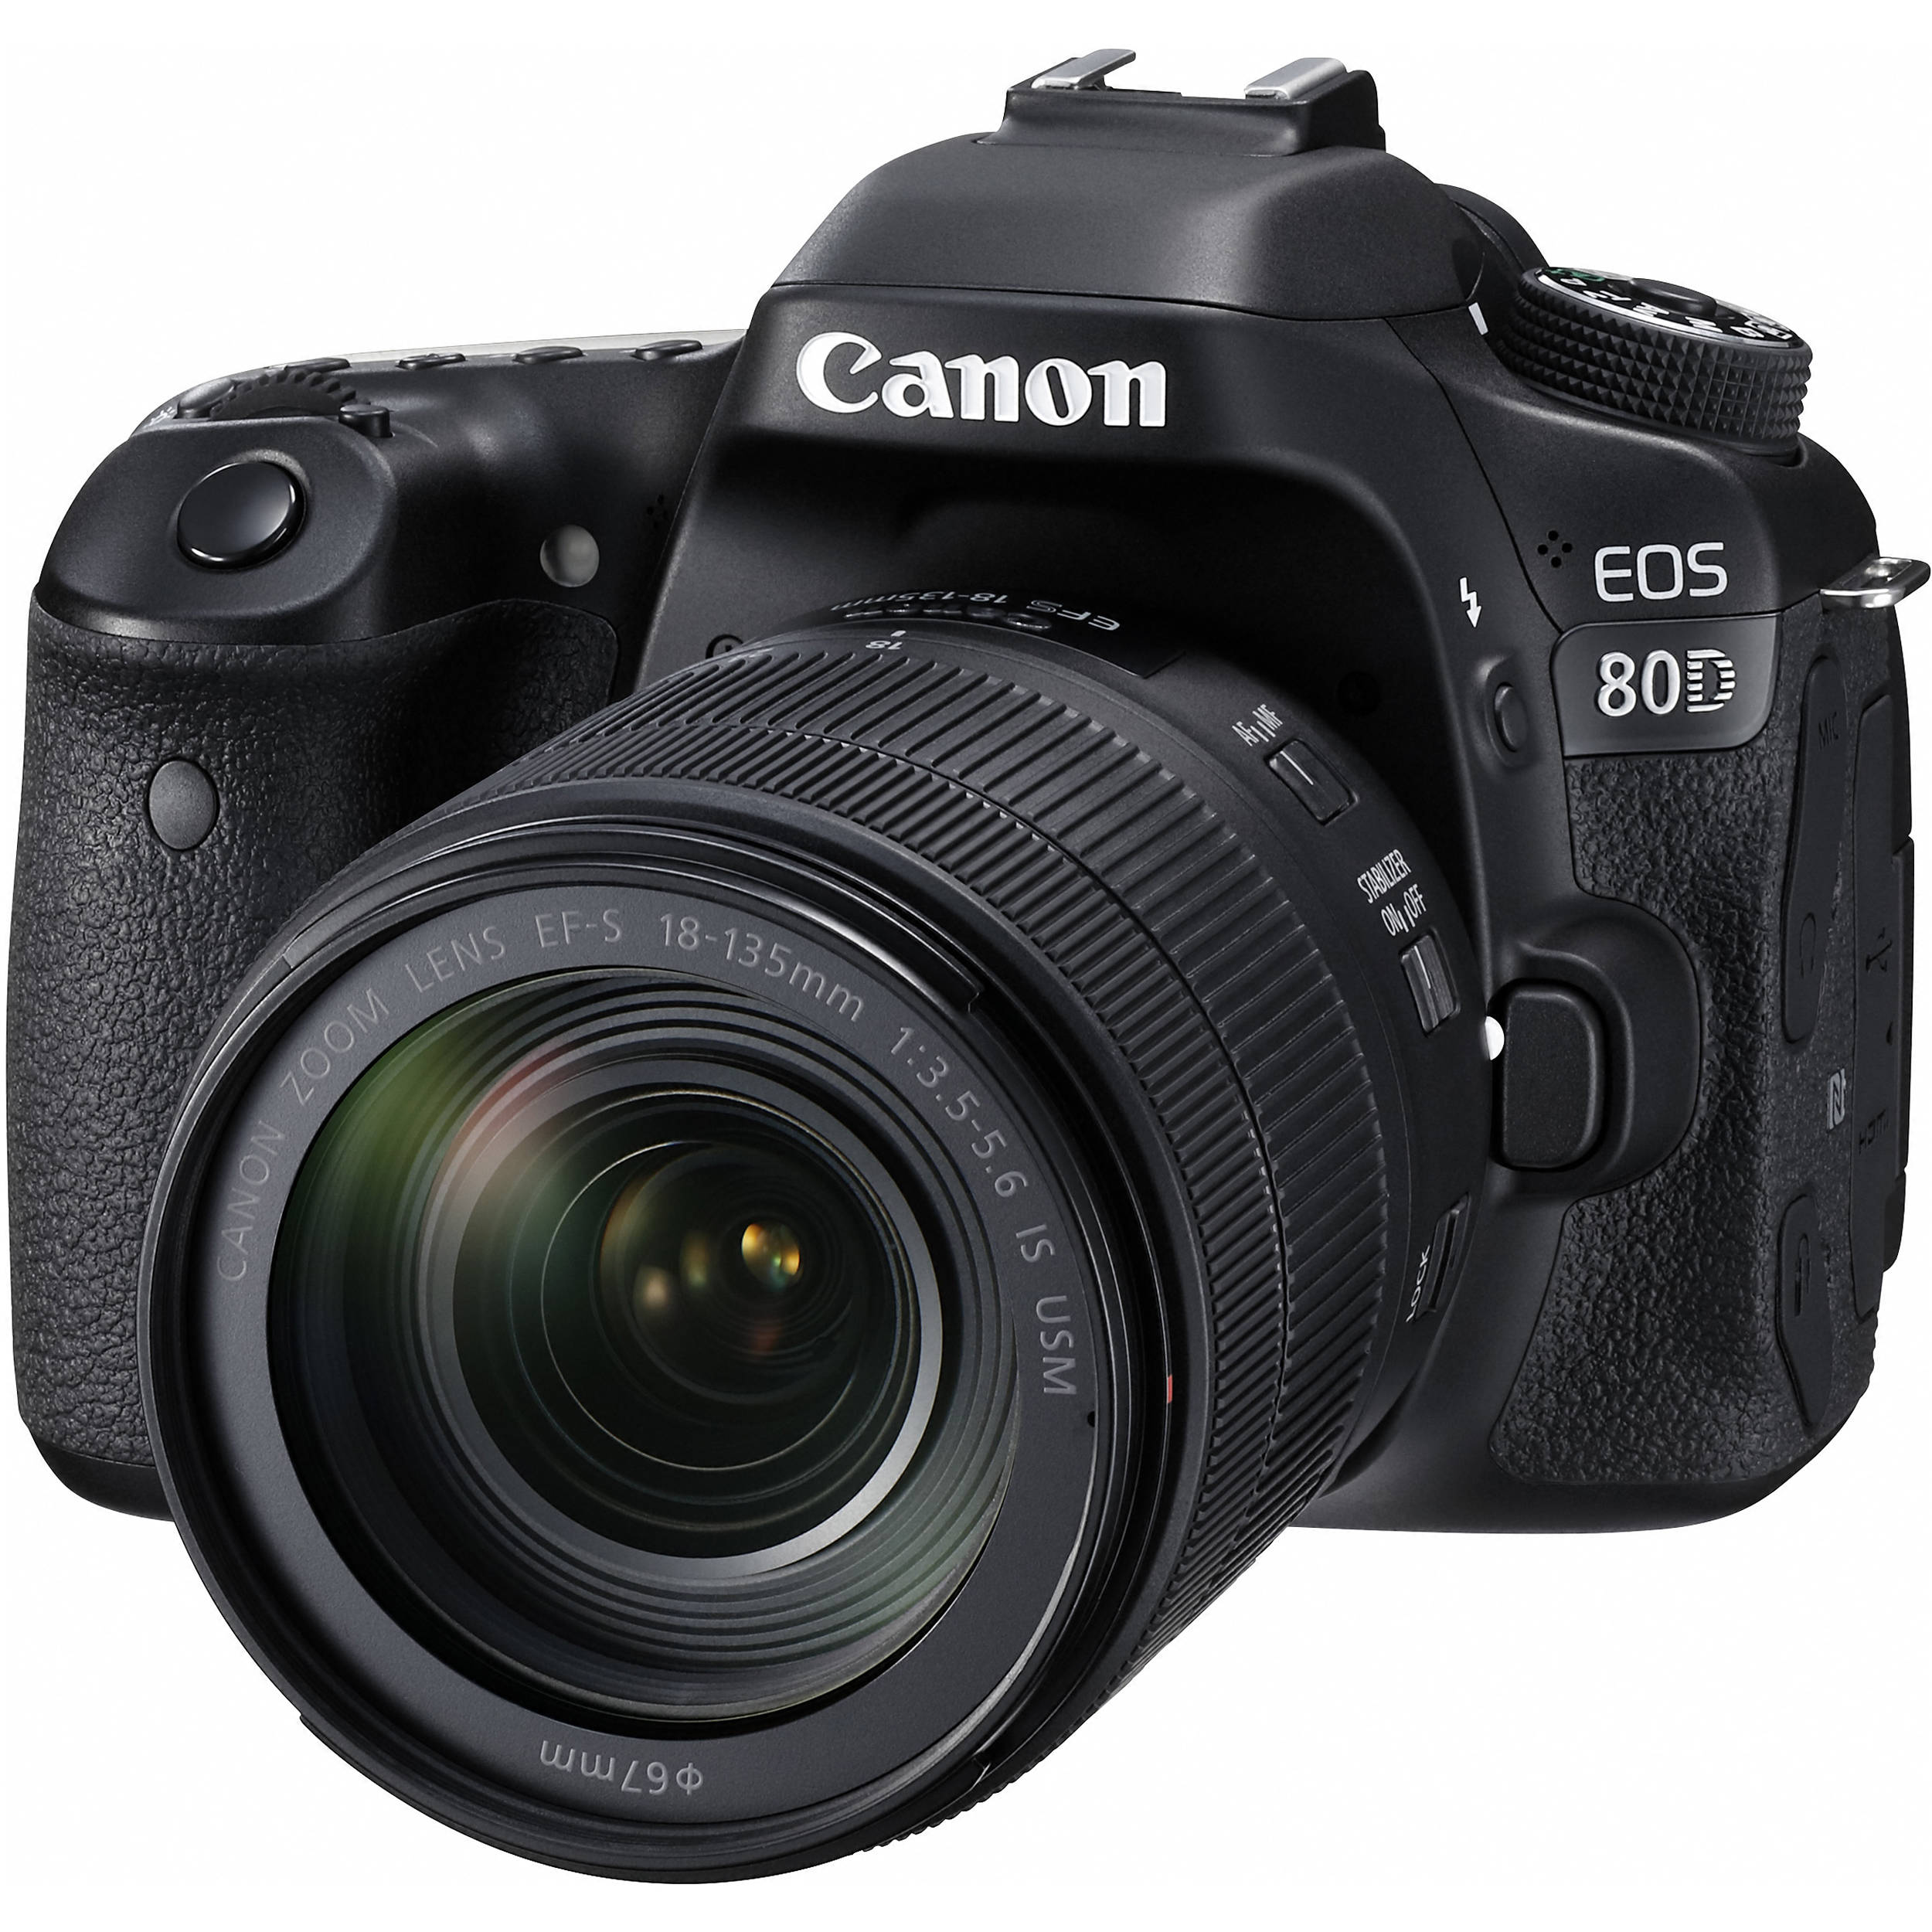
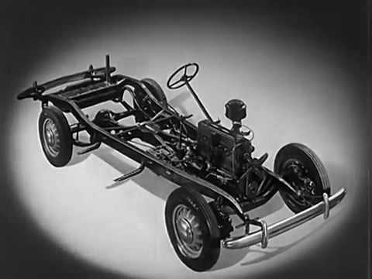

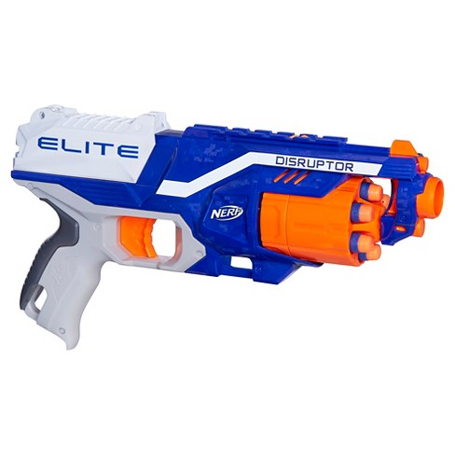

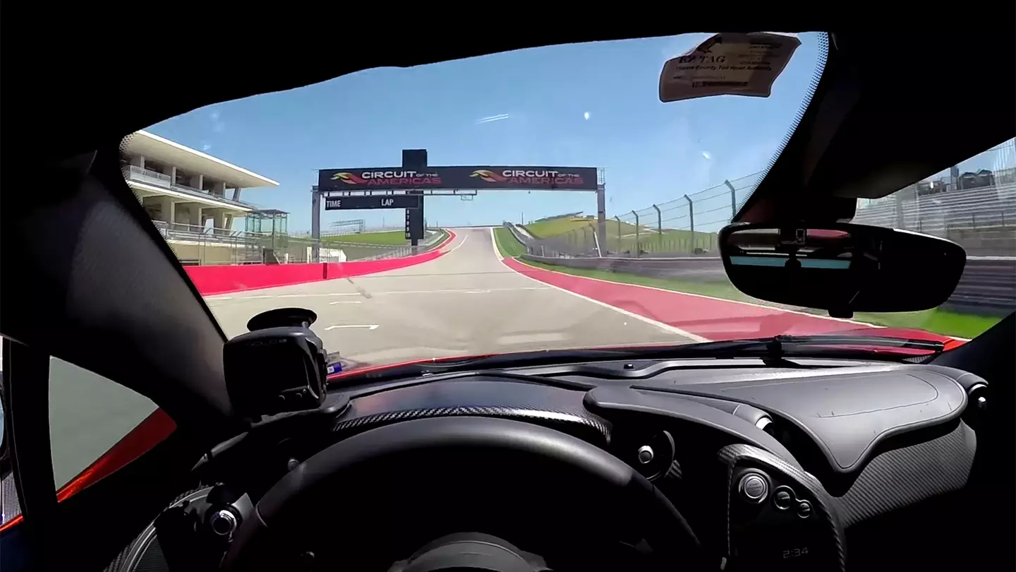

Overview - User Interface
Notes:
Andrew

Slide 4
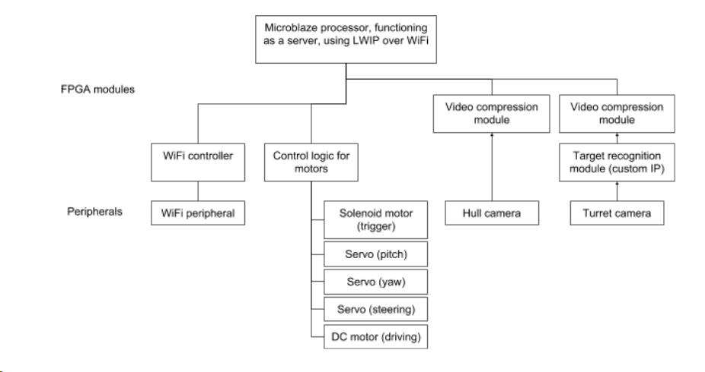
Originally Proposed System - Block Diagram
Notes:
Will

Slide 5
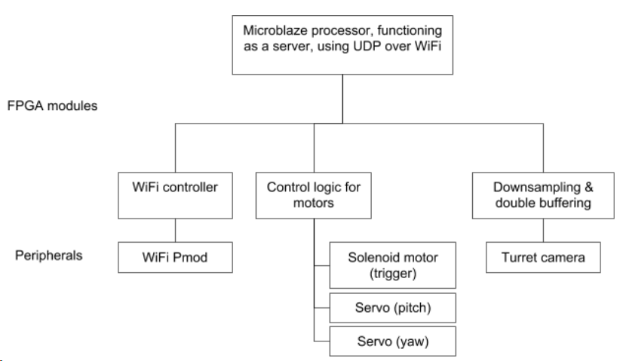
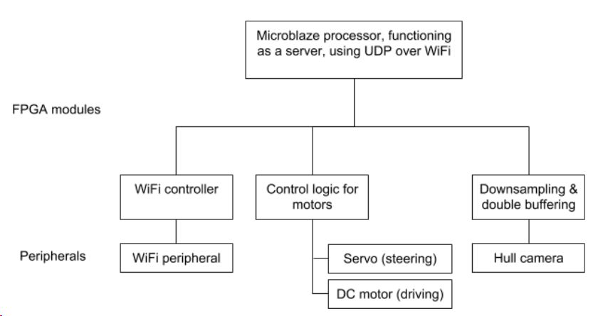
Current System - Block Diagram
Gunner FPGA
Driver FPGA
Notes:
Will

Slide 6
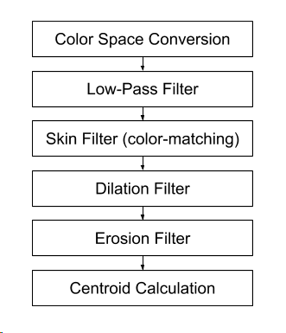
Originally Proposed System - Custom IP
Notes:
Edwin

Slide 7
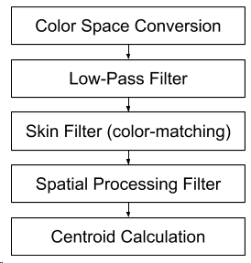
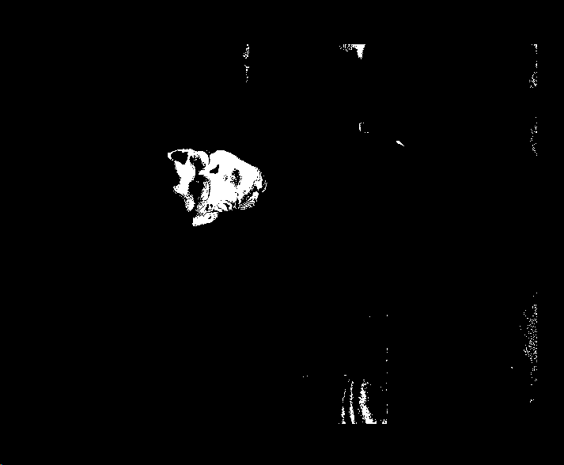
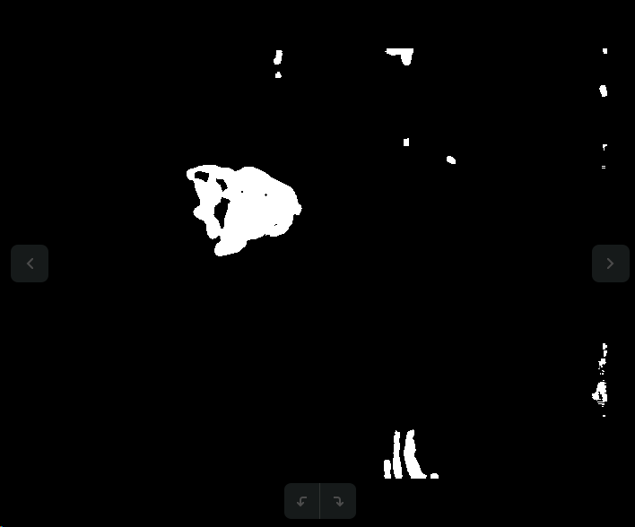
Current System - Custom IP
Notes:
Edwin

Slide 8

Challenges So Far...
Difficulties in finding fast enough connected component & centroid algorithms in hardware
Vivado version differences 2017.4 -> 2018.1 -> 2018.3 -> 2017.4
There’s always a bigger error
Good Open Source Compression IP (H264, JPEG) doesn’t seem to exist, and Xilinx’s H264 module is only compatible with ultrascale FPGA’s
Noisy wireless networks leading to high latency and packet loss
WiFi throughput issues
Limited power delivery
Notes:
Edwin -> Will -> Andrew

Slide 9
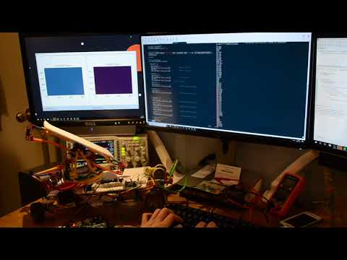
Demo - Wifi controlled motors
Notes:
Andrew

Slide 10
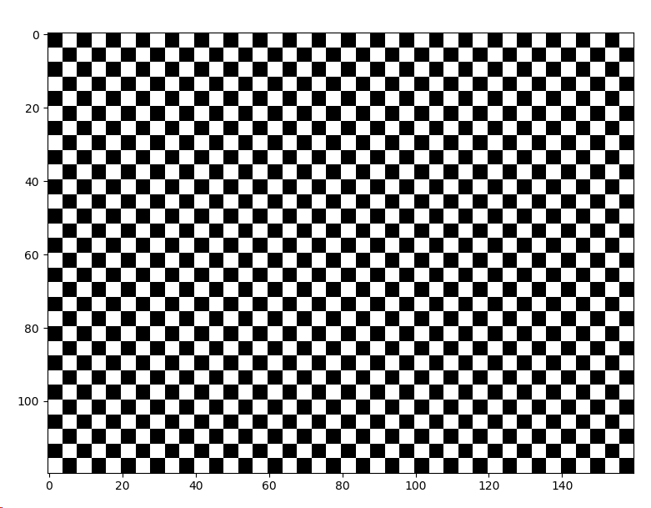
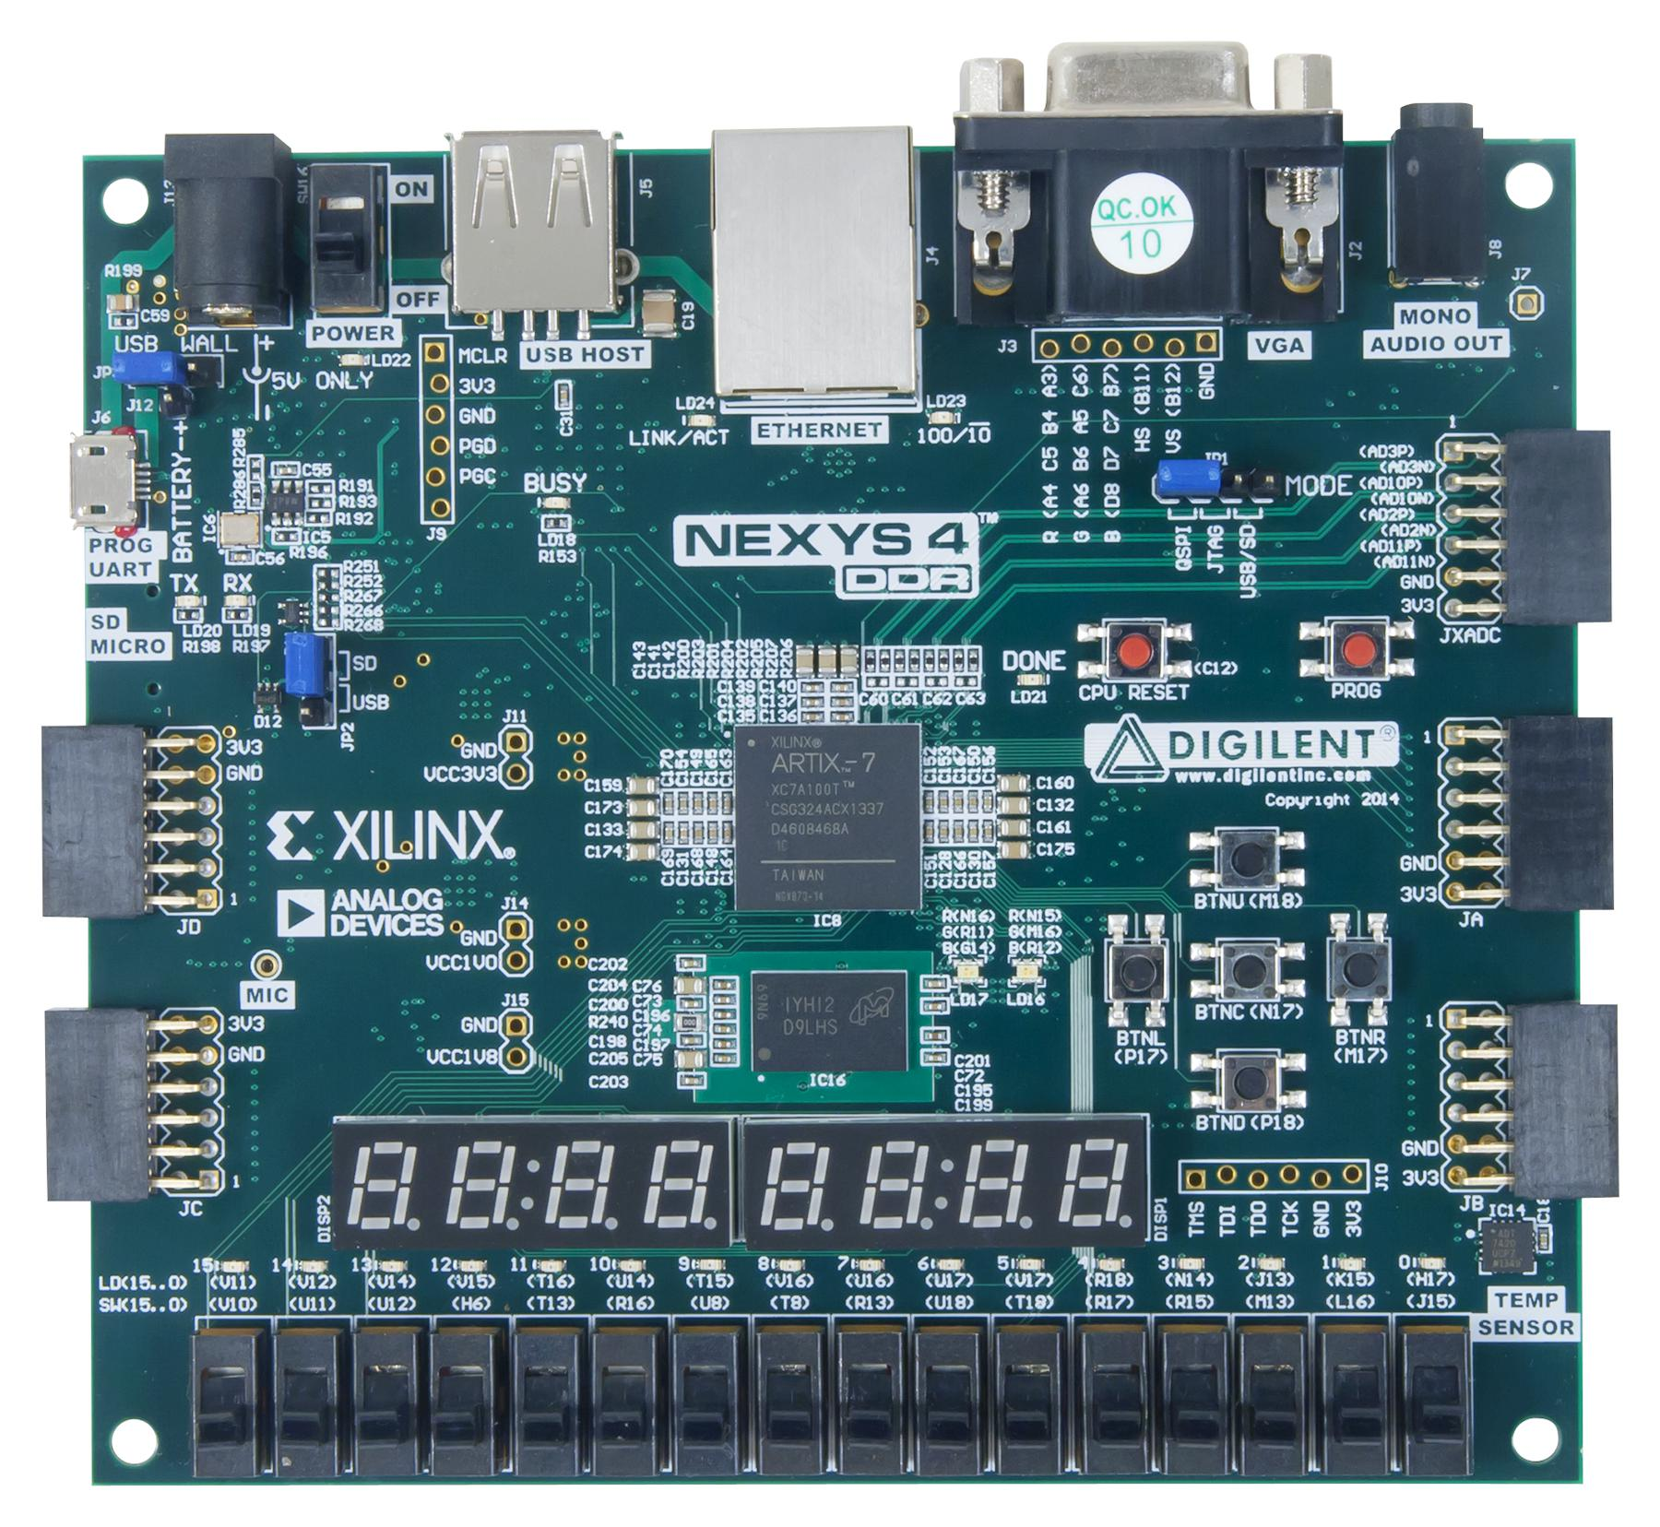
Demo - Streaming a predefined image over WiFi
Notes:
Will

Slide 11
What’s left to do? Are we on track?
Planned:
Physical vehicle completed, controllable over WiFi
Streaming 160x120 raw video
Target recognition IP fully implemented in hardware
Achieved:
Physical vehicle completed, controllable over WiFi
Streaming 160x120 video at low-framerate
Target recognition IP successfully does all pre-processing and filtering
Remaining:
Improve video throughput
Final pipeline stage of target recognition IP
System integration, set up DMA for connecting Pmod camera to custom IP
Notes:
Edwin

Slide 12
Questions?

